Slide 1


Introduction to
Robotic Process Automation
Internship and Scholarship application Tracker
Your Register No : 220701119
Name : Karthiga R
Guide Name : Mrs. J. Jinu Sophia
Designation and Department : Assistant
Professor (SG)

Slide 2
Abstract
The Scholarship and Internship Application Tracker -solution that automates the management of scholarship and internship opportunities. Using UiPath, the system extracts details such as titles, deadlines, and qualifications from online sources, stores them in Excel, and calculates time remaining for deadlines. It sends automated email reminders for approaching deadlines, ensuring timely action. This project simplifies application tracking, reduces manual effort, and enhances efficiency in managing career opportunities.

Slide 3
Need for the Proposed System
Managing scholarship and internship applications can be a time-consuming and error-prone process, especially when dealing with multiple opportunities and strict deadlines. The proposed these challenges by automating the following tasks:
      Efficient Data Management
      Timely Reminders
      Centralized Tracking
      Error Reduction
      Improved Productivity

Slide 4
Advantages of the Proposed System
        Automation of Repetitive Tasks
        Time Efficiency
        Accurate Deadline Management
        Improved Productivity
        Scalability

Slide 5
Literature Survey
Paper 1: "RPA for Streamlining Application Tracking Systems"
- Advantages:
Demonstrates how RPA can automate data collection and management tasks, significantly reducing manual effort . Provides a robust framework for integrating email notifications for reminders.
Improves process accuracy and efficiency in managing deadlines and applications.
- Disadvantages:
Limited to structured data sources, making it less effective for extracting information from unstructured content.
High initial setup time for configuring workflows and integrating with various platforms.
Paper 2: "Automation in Educational and Career Planning Using RPA"
- Advantages:
Highlights the potential of RPA in career planning, including scholarship and internship management.
Supports scalability to handle multiple opportunities across different platforms.
Demonstrates cost-effectiveness by reducing reliance on manual labor for repetitive tasks.
- Disadvantages:
Requires technical expertise to design and implement workflows, which may limit adoption among non- technical users.
Dependency on third-party tools or APIs, such as email or data scraping, which can introduce additional challenges in integration.

Slide 6
Main Objective
The primary objective of the Scholarship and Internship Application Tracker is to automate the process of managing, tracking, and organizing scholarship and internship opportunities. This includes:
      Efficient Data Extraction
      Deadline Tracking and Notifications
      Streamlined Application Management
      Enhanced Productivity

Slide 7
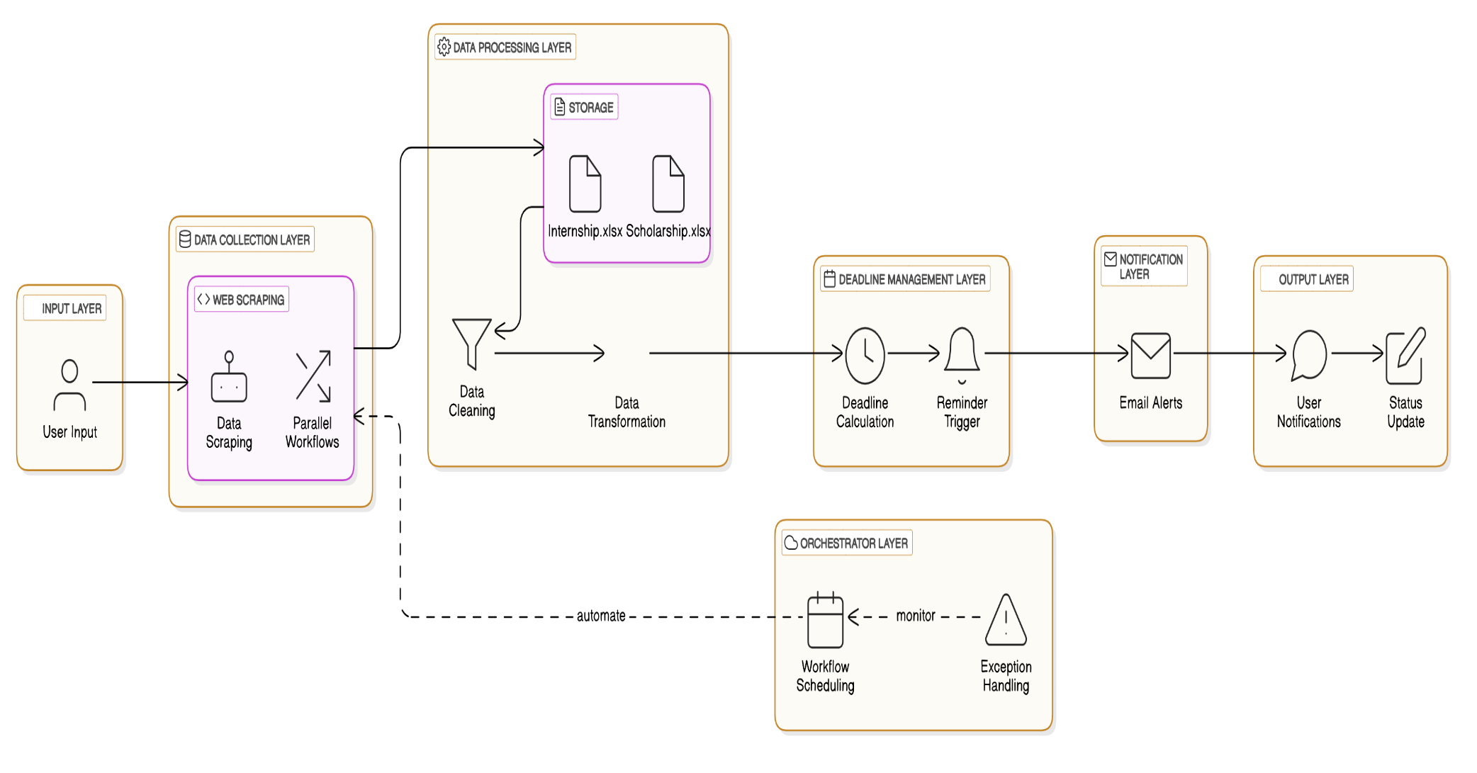
Architecture

Slide 8
Software System Requirements
    Operating System: Windows 10 or later
    RPA Tool: UiPath Studio (Community or Enterprise Edition)
    Excel: Microsoft Excel 2016 or later for data storage and processing
    Email Client: SMTP-compatible email service (e.g., Gmail, Outlook)
    Browser: Google Chrome or Mozilla Firefox with the UiPath extension installed
    Programming Language Support: .NET Framework for UiPath workflows

Slide 9
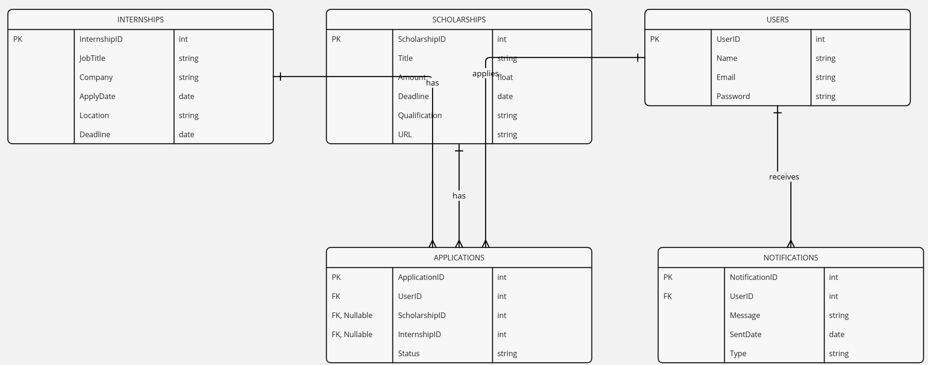
Entity Relationship Design

Slide 10
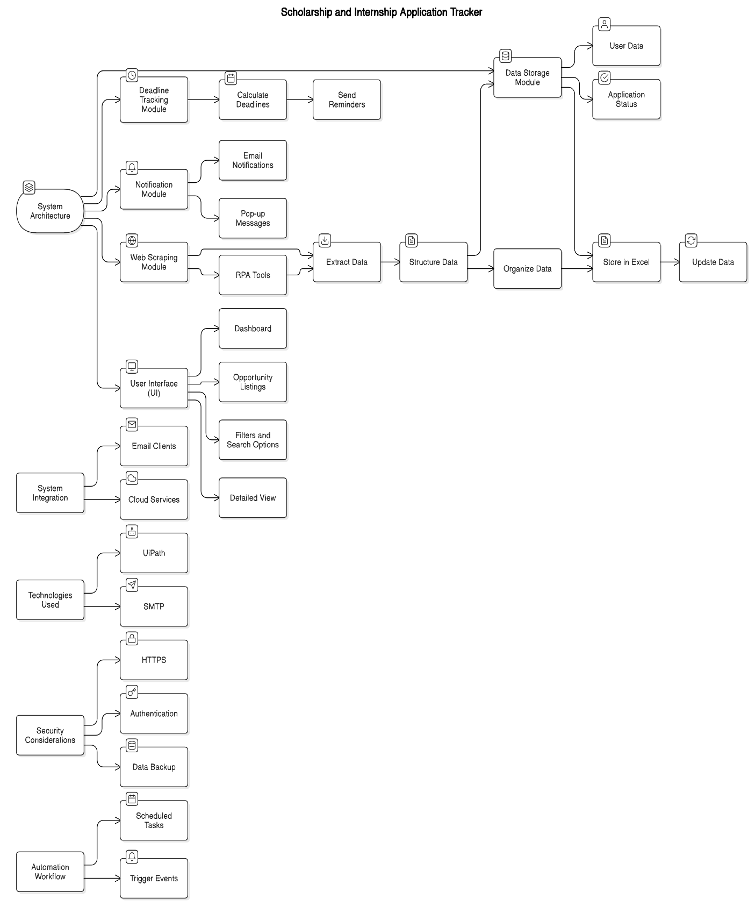
Process Design

Slide 11
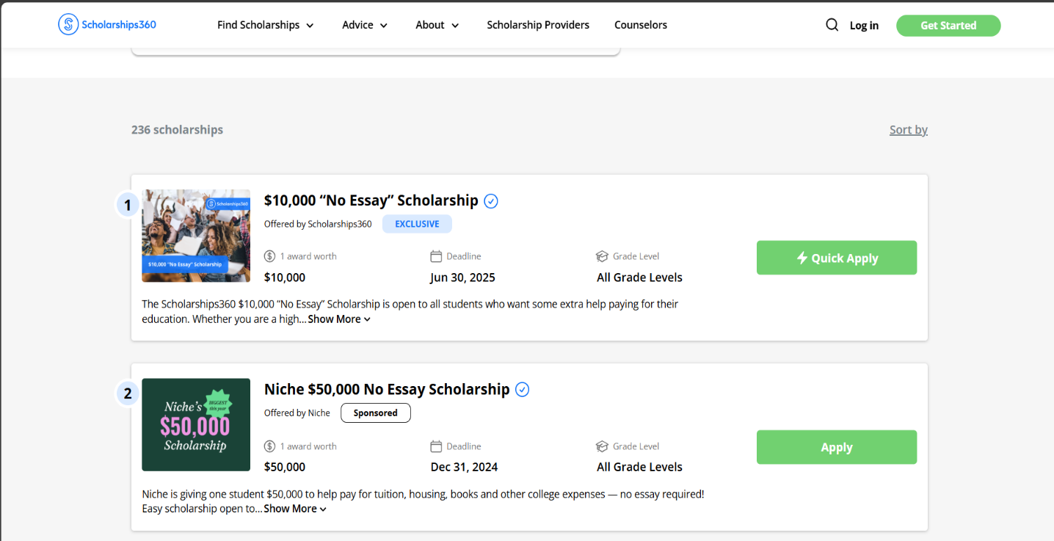
Implementation
a) Scholarship website:-

Slide 12
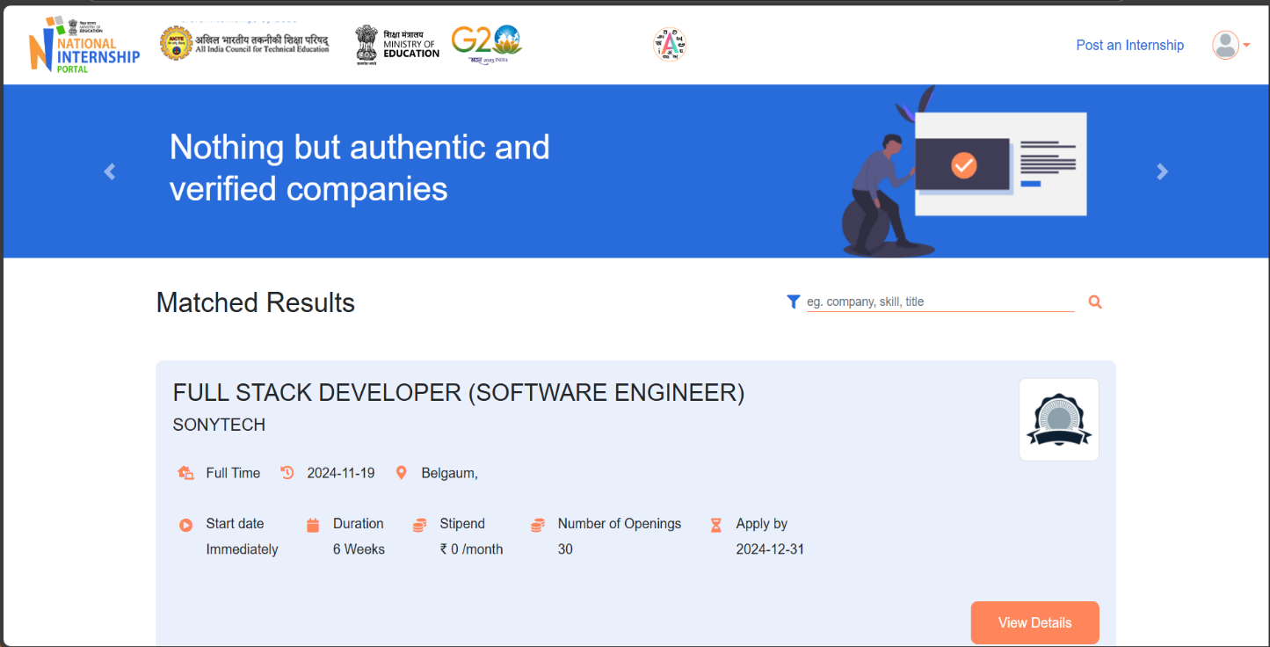
Implementation
b) Internship website:-

Slide 13
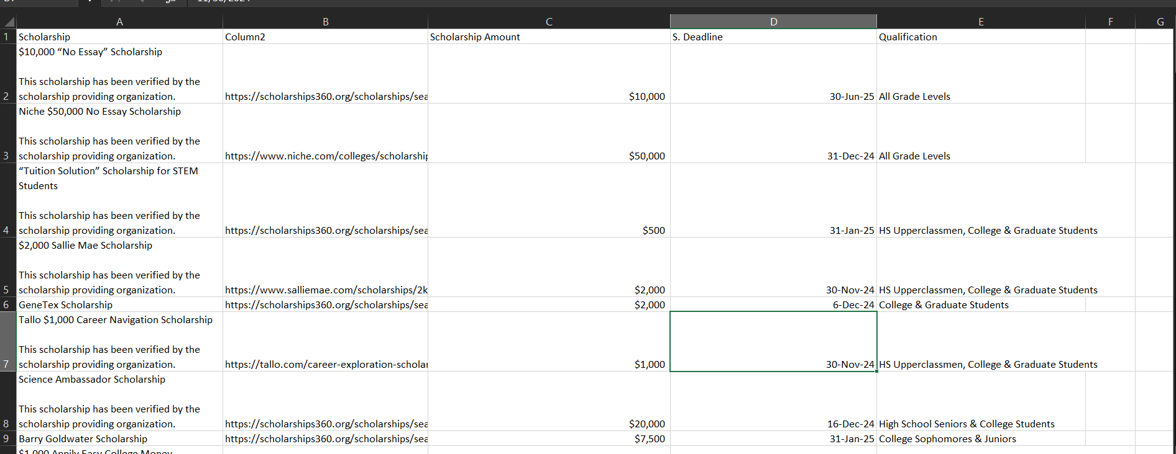
Implementation
c)Scholarship Excel

Slide 14
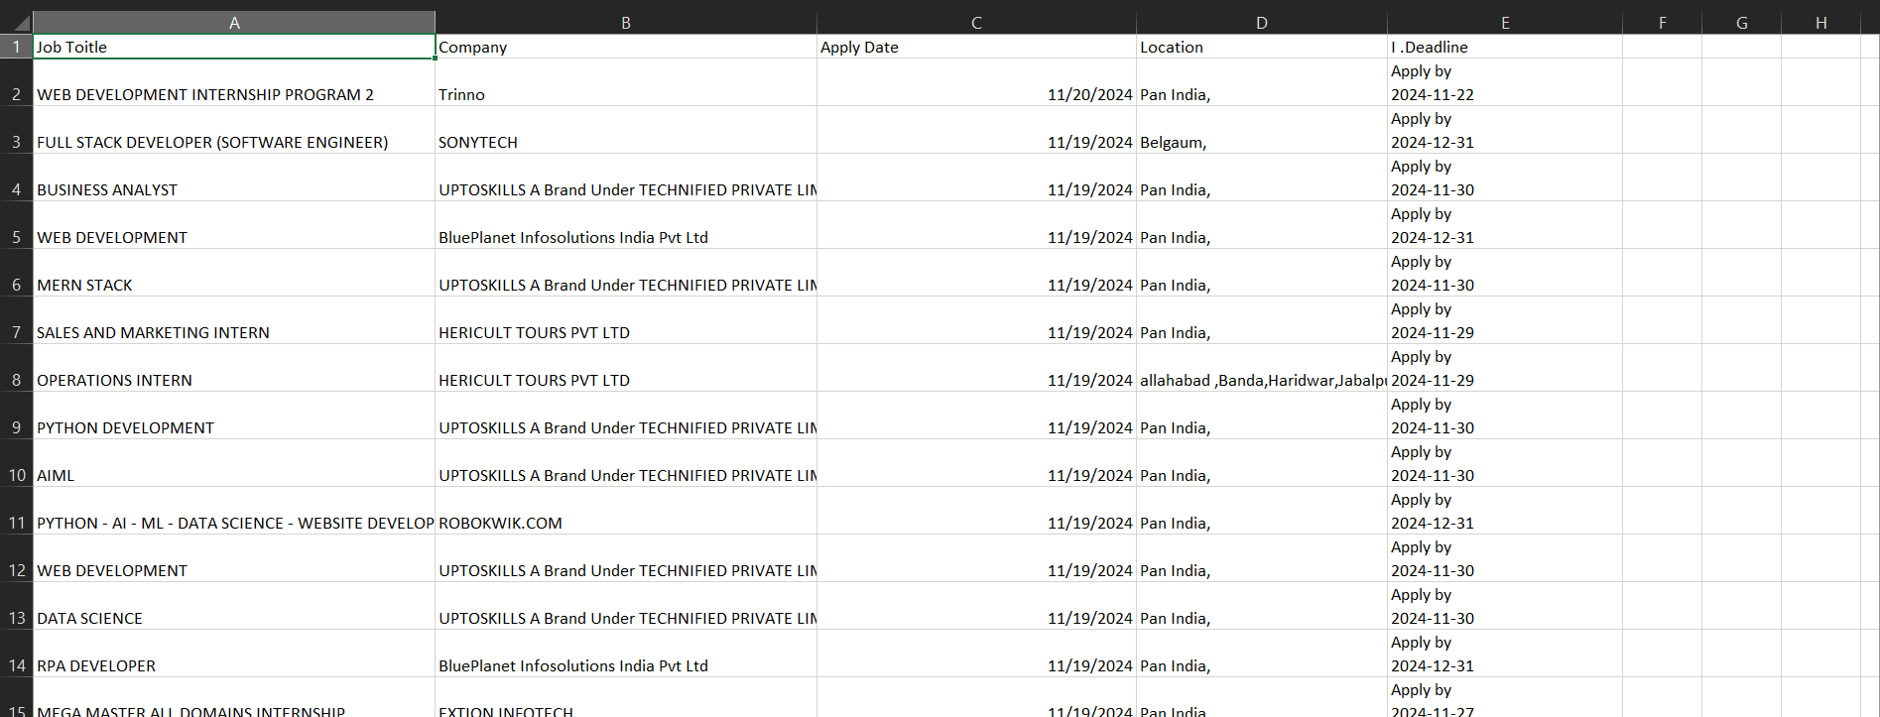
Implementation
d)Internship Excel

Slide 15
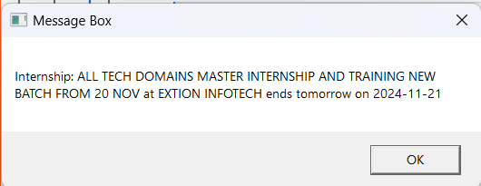
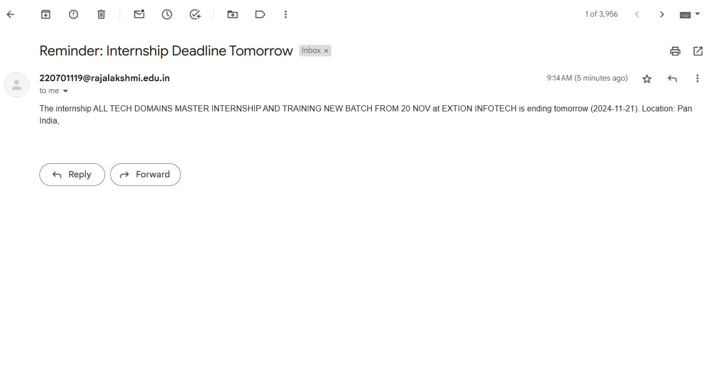
Implementation
e)Deadline Alert
f)Deadline Alert Mail

Slide 16
Conclusions
The Scholarship and Internship Application Tracker project successfully demonstrates the power of automation in streamlining the management of career opportunities, offering an efficient and error-free solution to a traditionally manual and time-intensive process. By leveraging UiPath and other automation technologies, the project achieves its core objectives of simplifying data collection, organizing information, and ensuring timely actions through robust notification mechanisms.

Slide 17
Future Enhancement
AI-Powered Recommendation System
Description: Incorporate a machine learning model to recommend scholarships and internships based on the user’s academic background, skills, preferences, and application history. This enhancement would make the system more personalized and efficient for users.
Mobile Application Development
Description: Develop a mobile application for Android and iOS platforms, allowing users to access and manage their applications on the go. The app would include features like real- time notifications, deadline tracking, and direct application submission.
Cloud Integration for Scalability
Description: Transition the system to a cloud-based infrastructure, allowing users to access their data from any device and location. Cloud integration would also enable easy scalability to handle a larger user base and additional features.
Real-Time Notifications with SMS and Push Alerts

Slide 18
References
UiPath Forum: The UiPath Forum community where users share their experiences and solutions. https://forum.uipath.com/
UiPath Documentation: The official documentation of UiPath features and functionalities https://docs.uipath.com/

Slide 19
Thank You

